Slide 1
Azure Databricks Introduction Joey Brakefield, Education Cloud Solution Architect

Slide 2

Big Data & Advanced Analytics at a glance
Ingest
Store
Prep & Train
Model & Serve
Intelligence
Business apps
Data Factory
(Data movement, pipelines & orchestration)
Cosmos DB
Predictive apps
Blobs
Data Lake
Databricks
HDInsight
Data Lake Analytics
SQL
Custom apps
Kafka
10 01
SQL Database
SQL Data Warehouse
Operational reports
Event Hub
IoT Hub
Machine Learning
Sensors and devices
Analysis Services
Analytical dashboards

Slide 3
Azure Databricks Powered by Apache Spark

Slide 4

Why Spark?
Open-source data processing engine built around speed, ease of use, and sophisticated analytics
In memory engine that is up to 100 times faster than Hadoop
Largest open-source data project with 1000+ contributors
Highly extensible with support for Scala, Java and Python alongside Spark SQL, GraphX, Streaming and Machine Learning Library (Mllib)

Slide 5
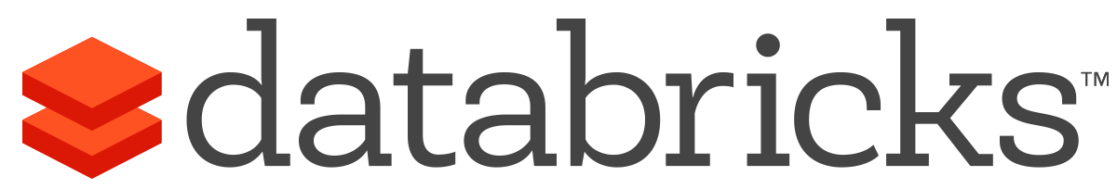


What is Azure Databricks?
A fast, easy and collaborative Apache® Spark™ based analytics platform optimized for Azure
Best of Databricks
Best of Microsoft
Designed in collaboration with the founders of Apache Spark
One-click set up; streamlined workflows + Azure Native Service Integration (VNet Integration + Storage)
Interactive workspace that enables collaboration between data scientists, data engineers, and business analysts.
Native integration with Azure services (Power BI, SQL DW, Cosmos DB, Blob Storage)
Enterprise-grade Azure security (Active Directory integration, compliance, enterprise-grade SLAs)

Slide 6
Differentiated experience on Azure
ENHANCE PRODUCTIVITY
BUILD ON THE MOST COMPLIANT CLOUD
SCALE WITHOUT LIMITS
Get started quickly by launching your new Spark environment with one click.
Share your insights in powerful ways through rich integration with Power BI.
Improve collaboration amongst your analytics team through a unified workspace.
Innovate faster with native integration with rest of Azure platform
Simplify security and identity control with built-in integration with Active Directory. Regulate access with fine-grained user permissions to Azure Databricks’ notebooks, clusters, jobs and data.
Build with confidence on the trusted cloud backed by unmatched support, compliance and SLAs.
Operate at massive scale without limits globally.
Accelerate data processing with the fastest Spark engine.

Slide 7
Technical Architecture

Slide 8

Azure Databricks
Azure Databricks
Collaborative Workspace
IoT / streaming data
Machine learning models
DATA ENGINEER
DATA SCIENTIST
BUSINESS ANALYST
Deploy Production Jobs & Workflows
Cloud storage
BI tools
MULTI-STAGE PIPELINES
JOB SCHEDULER
NOTIFICATION & LOGS
Data warehouses
Optimized Databricks Runtime Engine
Data exports
Hadoop storage
DATABRICKS I/O
APACHE SPARK
SERVERLESS
Rest APIs
Data warehouses
Enhance Productivity
Build on secure & trusted cloud
Scale without limits

Slide 9
Collaborative Workspace
GET STARTED IN SECONDS
Single click to launch your new Spark environment
INTERACTIVE EXPLORATION
Explore data using interactive notebooks with support for multiple programming languages including R, Python, Scala, and SQL
COLLABORATION
Work on the same notebook in real-time while tracking changes with detailed revision history, GitHub, or Bitbucket
VISUALIZATIONS
Visualize insights through a wide assortment of point-and-click visualizations. Or use powerful scriptable options like matplotlib, ggplot, and D3
DASHBOARDS
Rich integration with PowerBI to discover and share your insights in powerful new ways
Azure Databricks
Collaborative Workspace
DATA ENGINEER
DATA SCIENTIST
BUSINESS ANALYST
Deploy Production Jobs & Workflows
MULTI-STAGE PIPELINES
JOB SCHEDULER
NOTIFICATION & LOGS
Optimized Databricks Runtime Engine
DATABRICKS I/O
APACHE SPARK
SERVERLESS
Rest APIs

Slide 10
Deploy Production Jobs & Workflows
JOBS SCHEDULER
Execute jobs for production pipelines on a specific schedule
NOTEBOOK WORKFLOWS
Create multi-stage pipelines with the control structures of the source programming language
RUN NOTEBOOKS AS JOBS
Turn notebooks or JARs into resilient Spark jobs with a click or an API call
NOTIFICATIONS AND LOGS
Set up alerts and quickly access audit logs for easy monitoring and troubleshooting
INTEGRATE NATIVELY WITH AZURE SERVICES
Deep integration with Azure SQL Data Warehouse, Cosmos DB, Azure Data Lake Store, Azure Blob Storage, and Azure Event Hub
Azure Databricks
Collaborative Workspace
DATA ENGINEER
DATA SCIENTIST
BUSINESS ANALYST
Deploy Production Jobs & Workflows
MULTI-STAGE PIPELINES
JOB SCHEDULER
NOTIFICATION & LOGS
Optimized Databricks Runtime Engine
DATABRICKS I/O
APACHE SPARK
SERVERLESS
Rest APIs

Slide 11
Optimized Databricks Runtime Engine
OPTIMIZED I/O PERFORMANCE
The Databricks I/O module (DBIO) takes processing speeds to the next level — significantly improving the performance of Spark in the cloud
FULLY-MANAGED PLATFORM ON AZURE
Reap the benefits of a fully managed service and remove the complexity of big data and machine learning
SERVERLESS INFRASTRUCTURE
Databricks’ serverless and highly elastic cloud service is designed to remove operational complexity while ensuring reliability and cost efficiency at scale
OPERATE AT MASSIVE SCALE
Without limits globally
SUPPORT FOR GPU ENABLED VMS
Specialized compute for your deep learning needs
Azure Databricks
Collaborative Workspace
DATA ENGINEER
DATA SCIENTIST
BUSINESS ANALYST
Deploy Production Jobs & Workflows
MULTI-STAGE PIPELINES
JOB SCHEDULER
NOTIFICATION & LOGS
Optimized Databricks Runtime Engine
DATABRICKS I/O
APACHE SPARK
SERVERLESS
Rest APIs

Slide 12
General Spark Cluster Architecture
Driver Program SparkContext
‘Driver’ runs the user’s ‘main’ function and executes the various parallel operations on the worker nodes.
The results of the operations are collected by the driver
The worker nodes read and write data from/to Data Sources including HDFS.
Worker node also cache transformed data in memory as RDDs (Resilient Data Sets) or Dataframes
Worker nodes and the Driver Node execute as VMs in Azure
Cluster Manager
Worker Node
Worker Node
Worker Node
Cache
Cache
Cache
Task
Task
Task
Data Sources (HDFS, SQL, NoSQL, …)

Slide 13

Azure Databricks Cluster architecture
Spark History Server
Webapp
Log Daemon
Azure Compute
Spark Worker
Azure Compute
Azure DB for PostgreSQL
Spark Driver
Azure Compute
FileSystem
Service
Jobs
Cluster Manager
Azure Compute
Spark Worker
Log Daemon
Databricks’ Azure Account
User’s Azure Account
Resource in the Databricks’ account are not visible to users

Slide 14
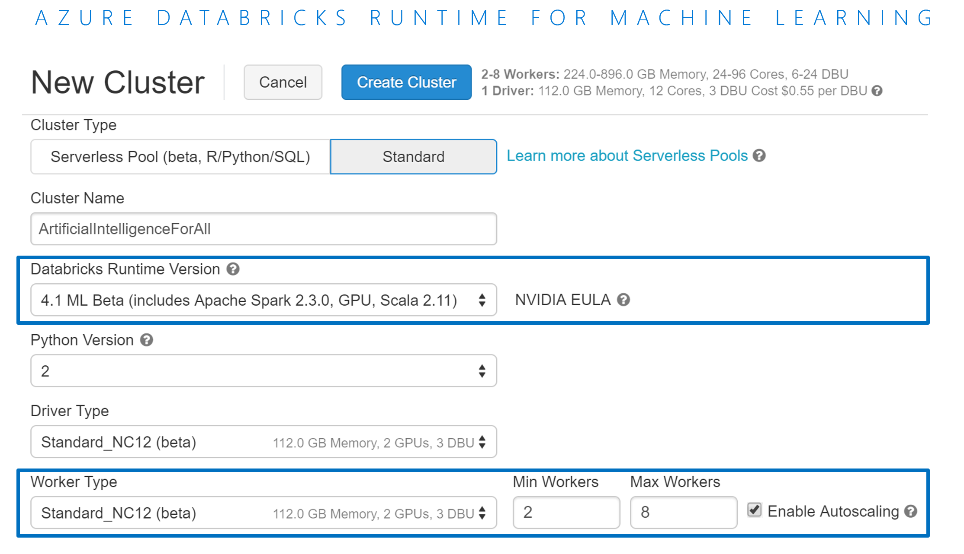
Azure Databricks Runtime for Machine Learning
Azure Databricks Runtime for Machine Learning
Pre-installed packages for machine learning like Tensorflow, Keras, Horovod and XGBoost
Pre-configured HorovodEstimator for seamless integration of Horovod with the Spark Dataframes
Support for GPU enabled VMs for specialized compute for your deep learning needs
Multi-GPU trainings of deep neural networks using Horovod
Unlock complex machine learning and deep learning scenarios with a few lines of code

Slide 15
3 Main Use Cases

Slide 16
Modern Big Data Warehouse
Ingest
Store
Prep & Train
Model & Serve
Intelligence
Logs, files and media (unstructured)
Data factory
Azure storage
Azure Databricks
(Spark)
Business / custom apps
(Structured)
Polybase
Data factory
Azure SQL Data Warehouse
Analytical dashboards

Slide 17
Advanced Analytics on Big Data
Ingest
Store
Prep & Train
Model & Serve
Intelligence
Logs, files and media (unstructured)
Data factory
Azure storage
Azure Databricks
(Spark Mllib, SparkR, SparklyR)
Azure Cosmos DB
Web & mobile apps
Business / custom apps
(Structured)
Polybase
Data factory
Azure SQL Data Warehouse
Analytical dashboards

Slide 18
Real-time analytics on Big Data
Ingest
Store
Prep & Train
Model & Serve
Intelligence
Unstructured data
Azure HDInsight (Kafka)
Azure Databricks
(Spark)
Polybase
Azure storage
Azure SQL Data Warehouse
Analytical dashboards

Slide 19
How to get started

Slide 20

How to get started
Ready to dive in? Try Azure Databricks with this GitHub Repo
Engage Microsoft EDU Team for a workshop to help identify high impact scenarios
Learn more about Azure Databricks www.azure.com/databricks

Slide 21
EDUCATION USE CASES

Slide 22


HEALTH & LIFE SCIENCES
DNA sequences
Real world analytics
Image deep learning
Sensor data
Social data listening
FAST-Q
BAM
SAM
VCF
Expression
HL7/CCD
837
Pharmacy
Registry
EMR
MRI
X-RAY
CT
Ultrasound
Readings
Time series
Event data
Social media
Adverse events
Unstructured
Genomics and precision medicine
Clinical and claims data
GPU image processing
IoT device analytics
Social analytics
Single cell sequencing
Biomarker, genetic, variant and population analytics
ADAM and HAIL on Databricks
Claims data warehouse
Readmission predictions
Efficacy and comparative analytics
Prescription adherence
Market access analysis
Graphic intensive workloads
Deep learning using Tensor Flow
Pattern recognition
Aggregation of streaming events
Predictive maintenance
Anomaly detection
Real-time patient feedback via topic modelling
Analytics across publication data
Faster innovation for drug development
Improved outcomes and increased revenue
Diagnostics leveraging machine learning
Predictive analytics transforms quality of care
Improved patient communications and feedback

Slide 23
SECURITY
Security controls to leverage all data
Actionable threat intelligence
Risk and fraud analysis
Compliance management
Identity and access management for analytics
Firewall/network logs
Apps
Data access layers
Firewall/network logs
Network flows
Authentications
Firewall/network logs
Web/app logs
Social media content
Firewall/network logs
Web
Applications
Devices
OS
Files
Tables
Clusters
Reports
Dashboards
Notebooks
Intrusion detection and predictive analytics
Security intelligence
Fraud detection and prevention
Security compliance reporting
Fine-grained data analytics security
Prevention of DDoS attacks
Threat classifications
Data loss/anomaly detection in streaming
Cybermetrics and changing use patterns
Real-time data correlation
Anomaly detection
Security context, enrichment
Offence scoring, prioritization
Security orchestration
e-Tailing
Inventory monitoring
Social media monitoring
Phishing scams
Piracy protection
Ad-hoc/historic incident reports
SOC/NOC dashboards
Deep OS auditing
Data loss detection in IoT
User behavior analytics
Role-based access controls
Auditing and governance
File integrity monitoring
Row level and column level access permissions
Transform security with improved visibility
Prevent complex threats with machine learning
Faster innovation for threat prevention
Risk management with machine learning
Limit malicious insiders to transform growth

